Slide 1
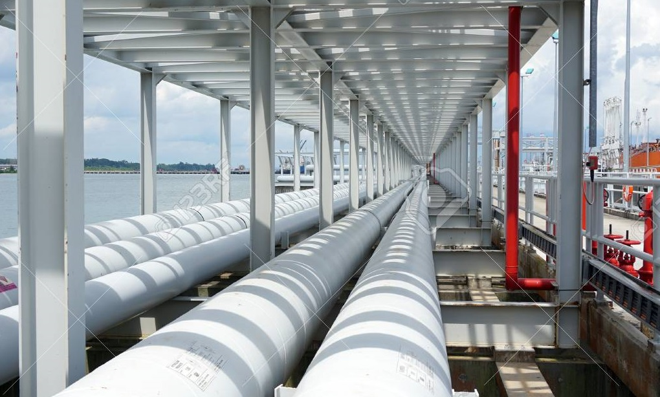


KASUS 6: current distribution AND Over PRotection on cathodic protection?
          Oleh:
          Lukman Hartono (Guest Lecture)
          NACE Certified Cathodic Protection Technologist
          NACE Certified Corrosion Technologist
          NACE Certified Protective Coating Technologist
          NACE Certified Coating Inspector level II
          Prof. Dr. Ir. Johny Wahyuadi Soedarsono
          Lecturer in University of Indonesia

Slide 2
Current Distribution

Slide 3
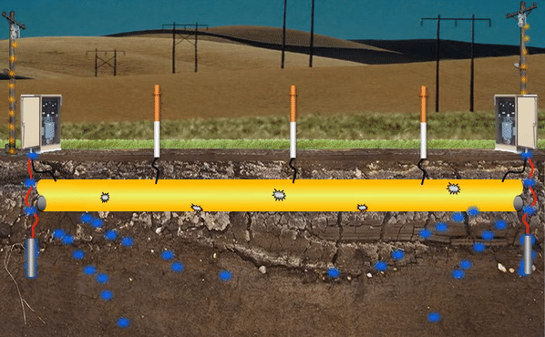
Current distribution
Single Groundbed

Slide 4
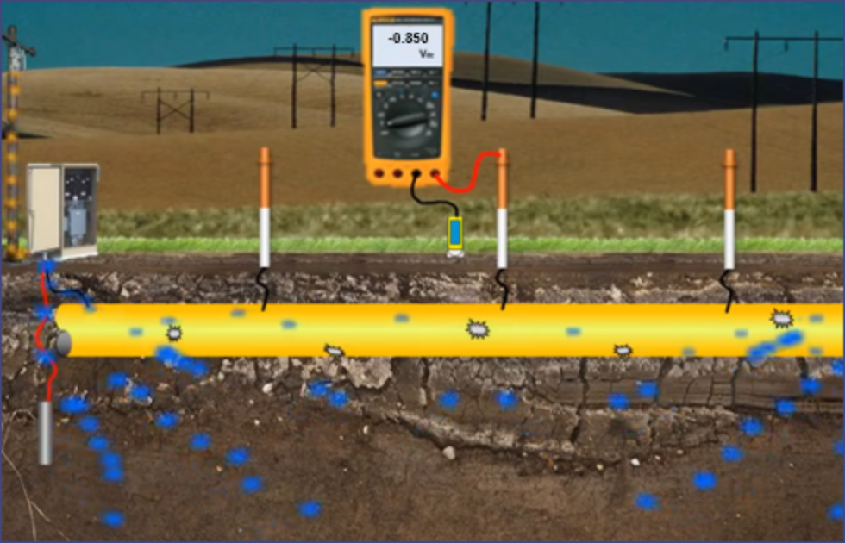
Current distribution
Pipa tidak seluruhnya terproteksi, dikarenakan Current Distribution tidak merata
-1200 mV
-850 mV
-810 mV
Terproteksi
Terproteksi
Tidak Terproteksi

Slide 5
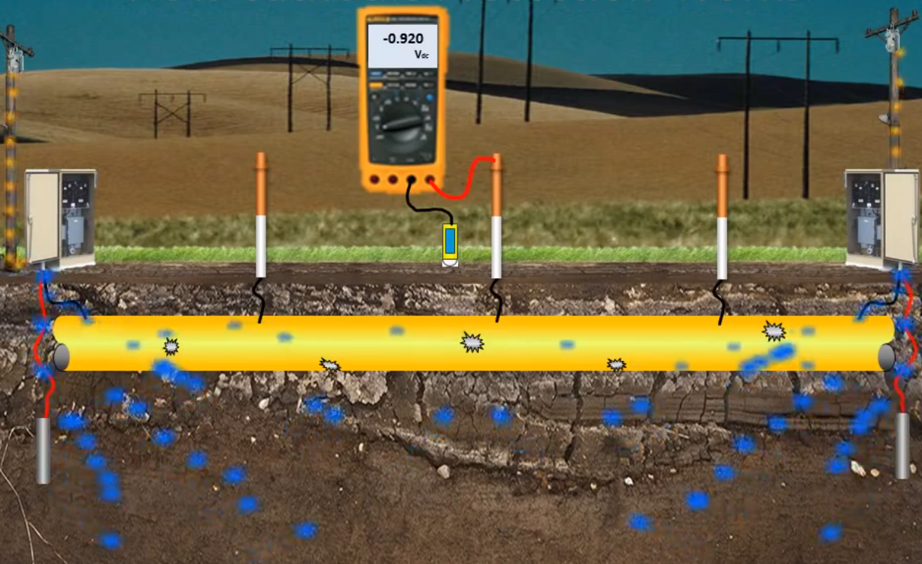
Current Distribution
Pipa terproteksi, tetapi terjadi overproteksi, dikarenakan Current Distribution tidak merata
-1500 mV
-920 mV
-850 mV
Over Proteksi
Terproteksi
Terproteksi

Slide 6
Current distribution
Pipa terproteksi, Distribusi arus merata
Multiple groundbed berfungsi untuk:
Protective current distribution yang lebih merata
Tingkat proteksi -850 mV/Cu-CuSO₄ lebih terjamin dibandingkan single groundbed
Meminimalisir problem overproteksi
Jika terjadi kerusakan pada satu system, system yang kedua dapat dioptimalkan
Mengantisipasi electrical shielding effect
Mengantisipasi jika ada penambahan surface area
-1000 mV
-950 mV
-1000 mV

Slide 7
Current Distribution
Initial Design harus mempertimbangkan hal-hal sebagai berikut:
Harus tetap terproteksi selama sesuai lifetime design (20-30 tahun)
Seluruh permukaan pipa harus terpolarisasi.
Seluruh permukaan pipa harus terproteksi dengan kriteria minimum -850 mV/Cu-CuSO4 Ref. cell
Mengantisipasi kerusakan coating di masa depan
Menghindari adanya overproteksi pada lokasi paling dekat dengan groundbed
Menghindari efek adanya electrical shielding
Mengantisipasi interference problem
Mengantisipasi perubahan electrolyte di masa depan
Kebocoran/Drainage arus proteksi
Mengantisipasi kemungkinan adanya penambahan luas area di masa depan
Kondisi Hazard pada oil & gas atau industri

Slide 8
Saran untuk cp designer
  Direkomendasikan:
  Pemilihan current density yang konservatif pada initial design
  Karena adanya kerumitan pada struktur terentu, maka designer CP dianjurkan sudah mempunyai pengalaman yang merujuk ke projek yang sama dan mempunyai pengalaman kerja minimum 5 tahun sebagai designer CP
  Site Supervision minimum NACE certified CP technician (level 2)
  Designer CP minimum NACE certified CP technologist (level 3)
  Testing & Commissioning minimum disaksikan oleh NACE certified CP technologist (level 3)

Slide 9
Current distribution
The amount of polarization and therefore the level of CP depend on the current density applied across the electrolyte/structure interface.
To achieve uniform protection at all locations on the structure under constant conditions requires uniform or ideal current density on all protected surfaces
However, ideal current distribution is impossible in practice, due to :
Non uniformity of electrolyte
Characteristic of structure
Placement of ground bed
Coating conditions
Factor effecting current distribution :
Variations in electrolyte resistivity
Anode to structure and anode to anode spacing
Protective coating conditions
Characteristic polarization
Variation in electrolyte geometry
Structure resistance (current attenuation)
Placement of anode location

Slide 10
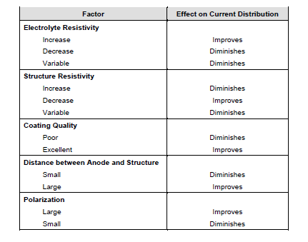
Current distribution
Cp 3 table 4.9 page 4.77

Slide 11
over protection

Slide 12
Over protection
Cathodic polarization at potential more electronegative than the static anode potential has no benefits and can be detrimental to the structure or coating disband from the substrate.
For pipeline coating more negative than minus -1200 mV CSE instant off potential should be avoided
Over protection can be detrimental to amphoteric metal (aluminium, zinc and lead),
Which may be corrode at both acid and alkaline environments.
OH -> become alkaline
Excessive protection can result in hydrogen damage (hydrogen embrittlement)
Polarisasi yang terlalu negative dapat merusak sturktur dan coating (coating akan mengelupas)
Untuk pipeline coating sebaiknya dihindari lebih negative dari -1200 mV CSE (instant off potentials)
Over proteksi akan terjadi pada amphoteric metal (aluminium, zinc dan lead), yaitu logam yang akan terkorosi pada kondisi asam dan basa
Proteksi yang berlebihan akan menyebabkan hydrogen embrittlement, kerusakan coating karena adanya H2 yang berlebihan
H⁺ + e⁻ -> H asam
2H₂0 + O₂ + 4e⁻ -> 4OH⁻ basa

Slide 13
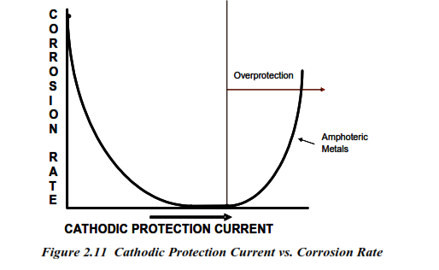
Over protection

Slide 14
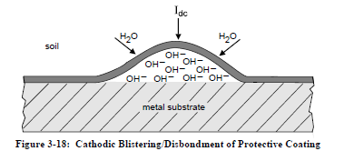
Blistering and coating disbondment at current pick up area
At the area of current pick up, a negative shift will result in cathodic polarization.
If the foreign structure is mild steel there is a beneficial effect as the structure receiving some more cp current.
If the structure is coated and has its own CP system, the additional polarization from the stray current may result in CATHODIC BLISTERING of the coating.
Coating blistering is caused by the pressure build up beneath the coating due to electro-osmotic movement of water through the coating
The high PH produced by the reduction reacton at the metal surface can attack the coating adhesion bonds resulting in coating disbondment
Cp3, bab3, figure 3.18 page 3.15
O₂ + 2H₂0 + 4e⁻ -> 4OH⁻
2H₂0 + 4e⁻ -> H₂ + 2OH⁻

Slide 15
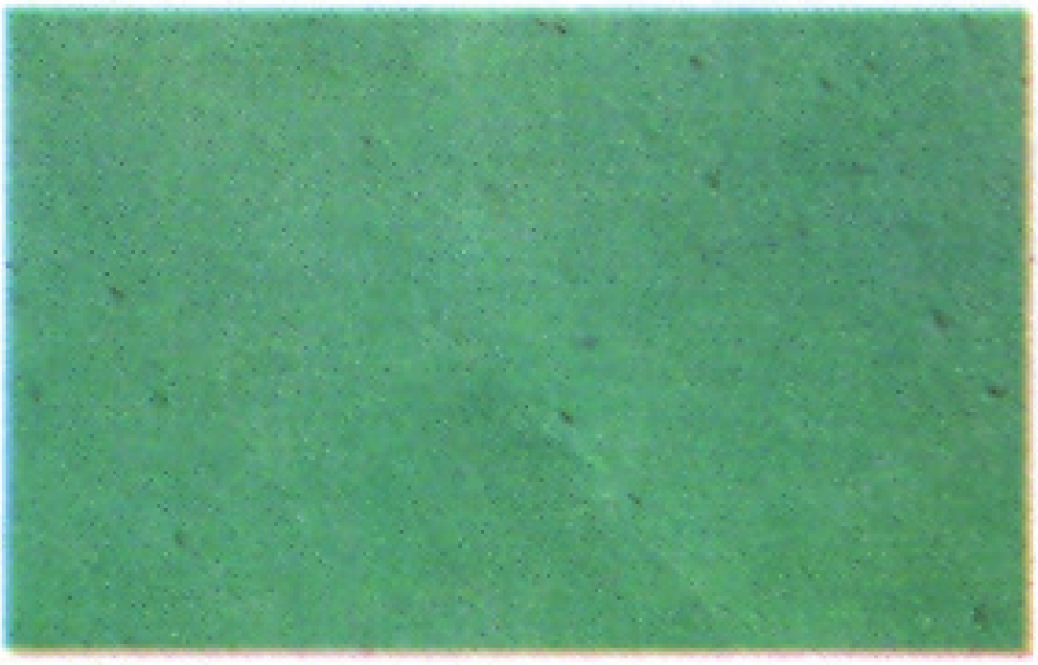
Blistering
Small to large broken or unbroken bubbles
Caused by solvent entrapment, moisture, or cathodic disbondment

Slide 16
THANK YOU

