Slide 1



KASUS 5:
Kriteria proteksi pada cathodic protection?
\
          Oleh:
          Lukman Hartono (Guest Lecture)
          NACE Certified Cathodic Protection Technologist
          NACE Certified Corrosion Technologist
          NACE Certified Protective Coating Technologist
          NACE Certified Coating Inspector level II
          Prof. Dr. Ir. Johny Wahyuadi Soedarsono
          Lecturer in University of Indonesia

Slide 2
Criteria for cathodic protection
The effectiveness of cathodic protection can be determine by methods that show corrosion on the structure is not occurring.
It is not practical to frequently inspect the surface is not corroded. Surrogate criteria can be used without waiting for evidence of corrosion
NACE standard SP0 169 (pipelines) : Control of external corrosion on underground or submerged metallic piping system
NACE standard RP 0193 (on-grade tanks)
NACE standard RP 0285 (U/G storage tanks)
Recognise 3 primary criteria :
The -850 mV/CSE potential criterion with current applied
The -850 mV/CSE polarized potential
The 100 mV polarization shift criterion

Slide 3
Criteria for cathodic protection
NACE SP 01 69, paragraph 6.2.2.1.1 :
A negative (cathodic) potential at least
-850 mV with the cathodic protection applied, this potential is measured with respect to a saturated Cu/CUSO4 reference electrode contacting the electrolyte.
Voltage drop other than those across the structure to electrolyte boundary must be considered for valid interpretation of the voltage measurement
Paragraph 6.2.2.1.2 :
a negative polarized potential of at least -850 mV/CSE.
Paragraph 6.2.2.1.3 :
a minimum of 100 mV of cathodic polarization between the structure surface and stable reference electrode contacting the electrolyte.
The formation or decay of polarization can be measured to satisfy this criterion

Slide 4
Criteria for cathodic protection
In measuring the P/S potential :
E measured = Ecorr + Vir + nc
Ecorr = corrosion potential
Vir = voltage drop
Nc = polarization
If the IR drop are removed, the remaining value represents the polarized potential of the structure
NACE SP0169,Paragraph 6.2.2.1.1 :
To evaluate ID drop by methods other than actual measurement of current interruption within the confines of sound engineering practices

Slide 5
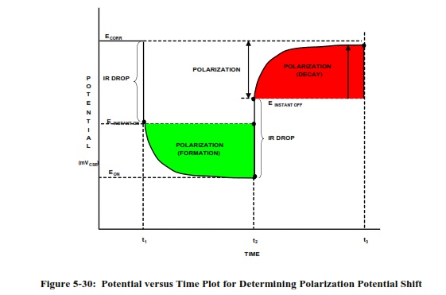
Criteria for cathodic protection
E on – E instant on >= 100 mV
E instant off – E corr >= 100 mV
E instant off – E decayed off >= 100 mV

Slide 6
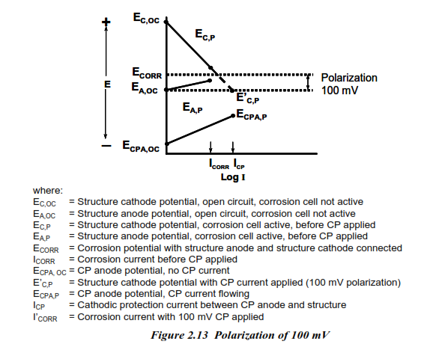
Basis of SP0169 criteria 100 mV polarization

Slide 7
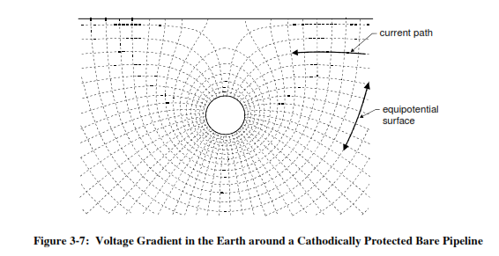
Voltage drop

Slide 8
THANK YOU

