Slide 1
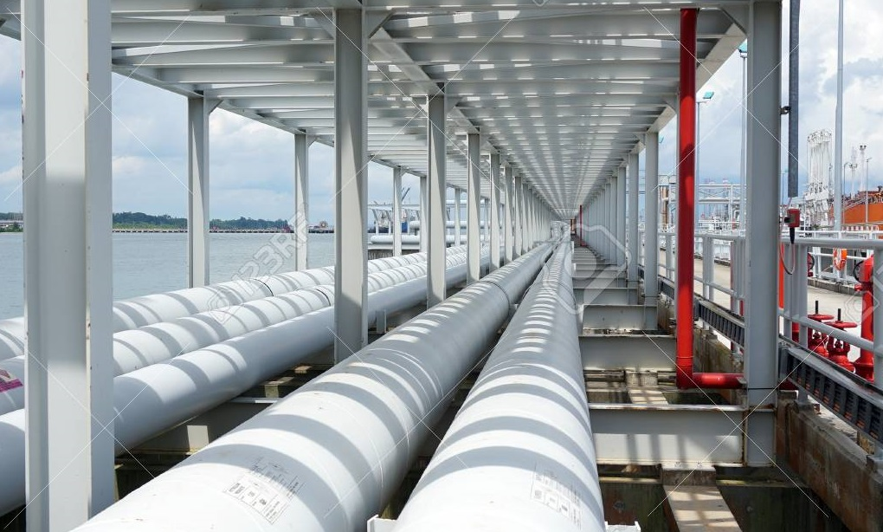


KASUS 2:
APakah stainless steel membutuhkan cathodic protection?
          Oleh:
          Lukman Hartono (Guest Lecture)
          NACE Certified Cathodic Protection Technologist
          NACE Certified Corrosion Technologist
          NACE Certified Protective Coating Technologist
          NACE Certified Coating Inspector level II
          Prof. Dr. Ir. Johny Wahyuadi Soedarsono
          Lecturer in University of Indonesia

Slide 2
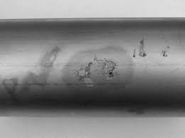
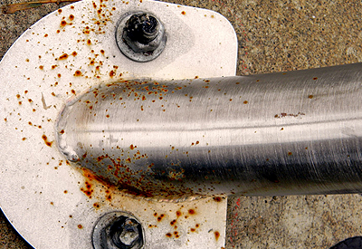
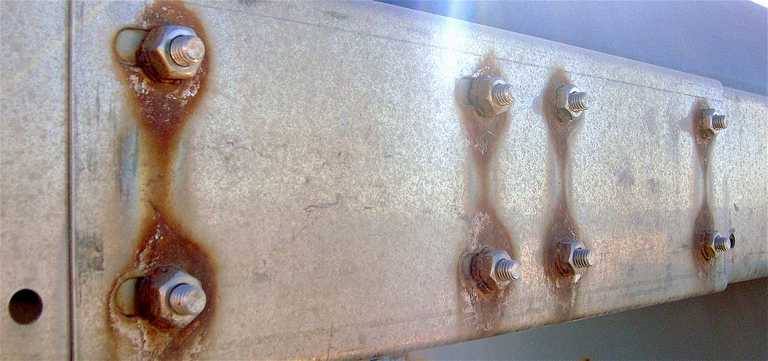
Diskusi:
Apakah stainless steel perlu diberikan cathodic protection?
Stainless steel adalah ferrous alloy yang di dalamnya terdapat alloy chromium. Campuran/alloy ini mempunyai thin oxide passive film pada permukaan. Passive film ini berfungsi sebagai barrier terhadap ion-ion penyebab korosi. Apabila passive film pada stainless steel underground pipe ini rusak, maka stainless steel akan terjadi concentrate corrosion di area tersebut sehingga akan terjadi piting corrosion dan lama-kelamaan akan terjadi leaking.

Slide 3
Diskusi:
Jawaban Lanjutan:
Oleh karena itu underground stainless steel pipe sebaiknya juga diproteksi dengan cathodic protection system.
Berdasarkan Jurnal “Corrosion Resistance of Stainless Steels in Soils and in Concrete” oleh Pierre-Jean Cunat, yang telah dipresentasikan pada komite “study of pipe corrosion” di Ceocor, France, 2001, dikatakan bahwa:
“Based on limited experience to soil conditions, stainless steel could be subject to corrosion if the soil resistivity is less than 700 Ω.cm indicative of a wet soil containing chlorides.”

Slide 4
Diskusi:
Berdasarkan NACE SP0169-2013: Control of External Corrosion on Underground or Submerged Metallic Piping System:
6.2.4 Criteria for Stainless Steel Piping
6.2.4.1 Criteria that have been documented through empirical evidence to indicate corrosion control effectiveness onspecific piping systems may be used on those piping systems or others with the same characteristics.
6.2.4.2 A minimum of 100 mV of cathodic polarization between the structure surface and a stable reference electrode contacting the electrolyte. Either the formation or the decay of this polarization must be used in this criterion.
6.2.4.3 A polarized potential of –450 mV or more negative with respect to a CSE in neutral or alkaline conditions. In acid conditions, the protection potential should be determined by testing.

Slide 5
Diskusi:
Berdasarkan German Standard DIN 30676
Material | Electrolyte | Potential V_{CSE}
Stainless steels with CR> 16% | Soil or fresh water and less than 40ºC | -100 mV
 | Soil or fresh water and higher than 40ºC | -300 mV
 | Salt Water | -300 mV
Aluminium | Fresh Water | -800 mV
 | Salt Water | -900 mV
Steel in contact with concrete | - | -750 mV

Slide 6
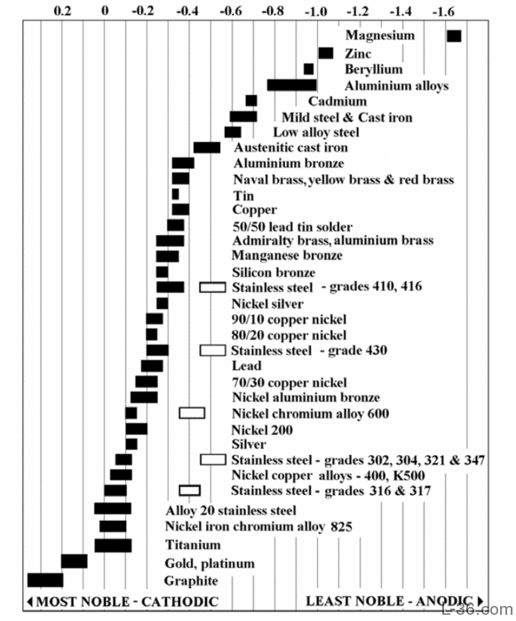
Volt
The table reports the Corrosion potentials or Galvanic Series of metals in flowing sea water at ambient temperature.
The unshaded symbols show ranges exhibited by stainless steels in acidic water such as may exist in crevices or in stagnant or low velocity or poorly aerated water where Stainless Steel become active, while the shaded areas show the potentials of Stainless Steel when is in passive state.

Slide 7
THANK YOU

