Slide 1
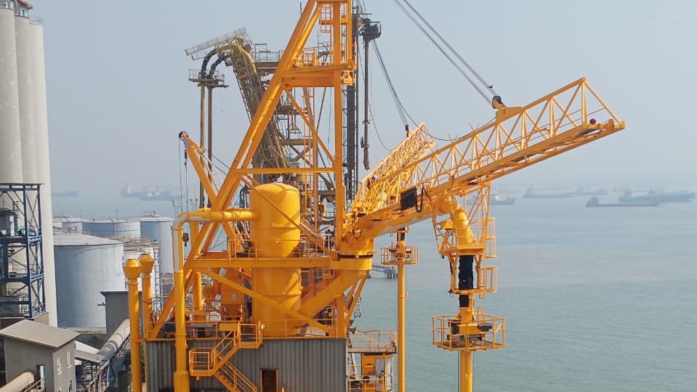


introduction

Slide 2
CV Lukman Hartono
Nama: Lukman Hartono
Alumni: S1 Teknik Perminyakan, Universitas Trisakti
International Professional Certification:
            NACE Certified Cathodic Protection Technologist CP3
            NACE Certified Corrosion Technologist
            NACE Certified Protective Coating Technologist
            NACE Certified Coating Inspector Level II

Slide 3
Riwayat Kerja
Bekerja di bidang anti korosi sejak 1990 hingga sekarang
Riwayat kerja:
Engineer pada DIMET Cathodic Protection tahun 1990 - 2000
Technical Director PT. Perintis Proteksi Sejahtera semenjak tahun 2000 - sekarang
Technical Director PT. TAM Victory Cemerlang semenjak tahun 2010 - sekarang
Website PERPRO : https://www.perintis-proteksi.com
Website TAM : https://www.tam-coating.co.id

Slide 4
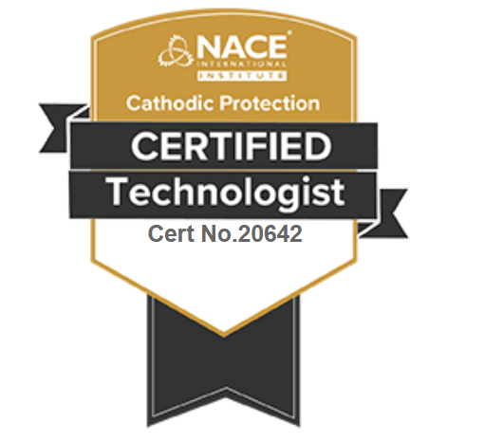
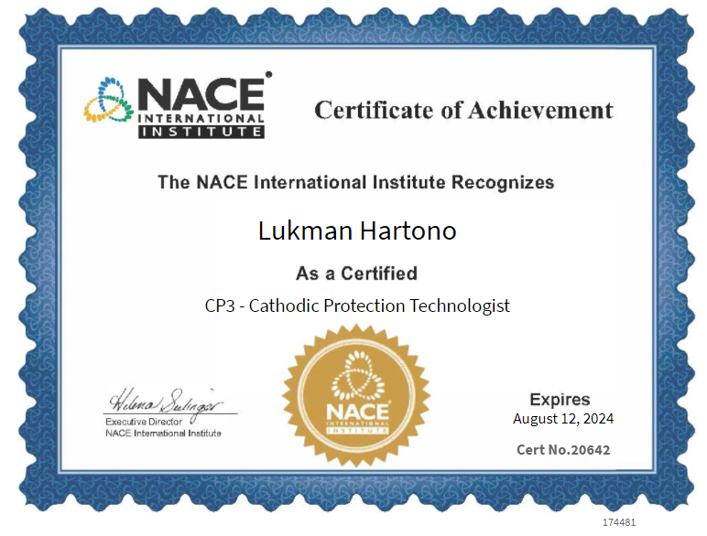
NACE CP3 - Cathodic Protection Technologist

Slide 5
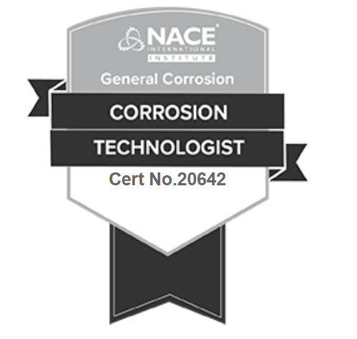
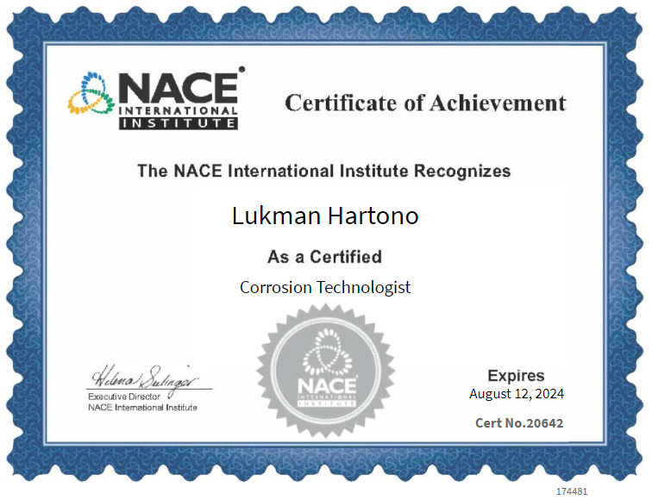
NACE Corrosion technologist

Slide 6
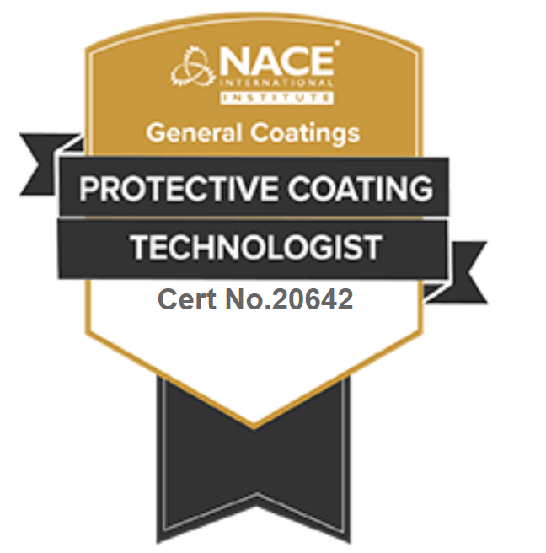
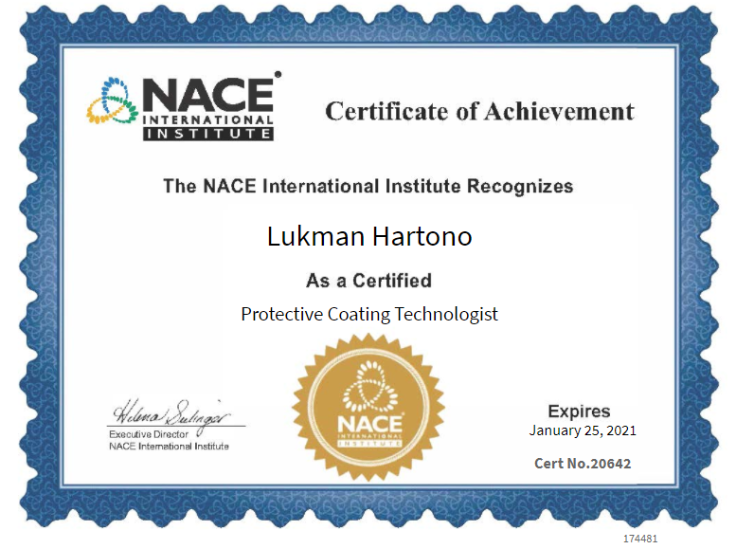
NACE Protective Coating Technologist

Slide 7
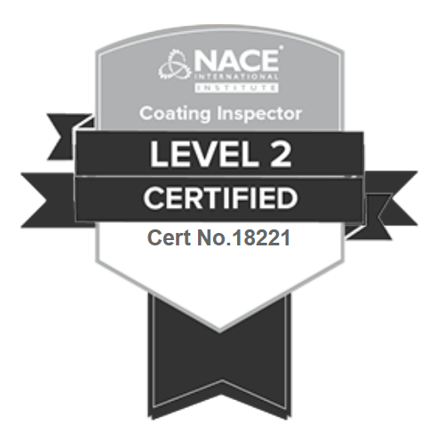
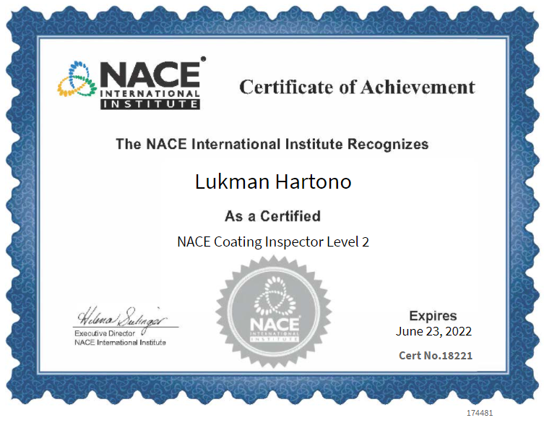
NACE COATING INSPECTOR LEVEL 2

Slide 8

tingkat sertifikasi nace
1. CP1 - Tester
Exploring the fundamental theory and practical techniques for testing and evaluating data to determine the effectiveness of both galvanic and impressed current Cathodic Protection systems and to gather design data.
2. CP2 - Technician
Intermediate-level training to perform field tests and identify different current measurements and voltage readings. Use data to determine the effectiveness of both galvanic and impressed current CP systems in mitigating corrosion.
3. CP3 - Technologist
Strong focus on the interpretation of CP data, troubleshooting, and migration of problems that arise in both galvanic and impressed current systems, including design calculations for these systems.
4. CP4 – Specialist
Focuses on the principles and procedures for CP design on a variety of structures for both galvanic and impressed current systems.

Slide 9
Penjelasan sertifikat NACE
Langkah Sertifikasi NACE
Hadir course: dapat sertifikat completion
Lulus Kuis
Lulus Essay
Lulus Theory
Proses sertifikasi dengan melampirkan pengalaman kerja dan surat referensi pihak ke-3
Keuntungan memiliki international certificate:
Mempermudah untuk dapat diterima bekerja di perusahaan multinasional, di dalam maupun di luar negeri.
Meningkatkan skill dalam ranah professional

Slide 10
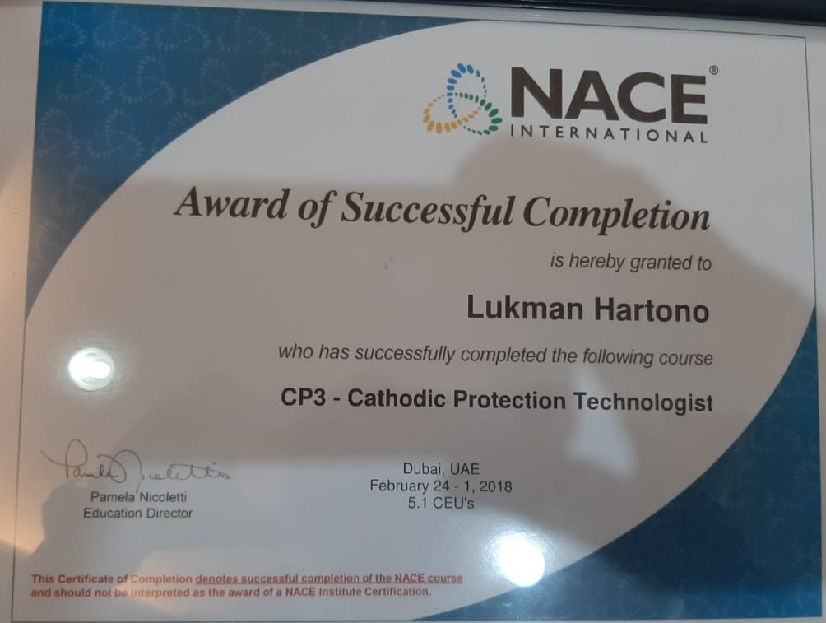
Perbandingan sertifikaT nace
Sertifikat Completion Menghadiri Course
& Belum Certified/Belum Lulus
Sudah memenuhi semua persyaratan dan
Sudah lulus menjadi certified CP3 - CP Technologist

Slide 11
THANK YOU

